Slide 1
EMB Good Practices for Disability Inclusion
Bill Sweeney
President and CEO
International Foundation for Electoral Systems

Slide 2
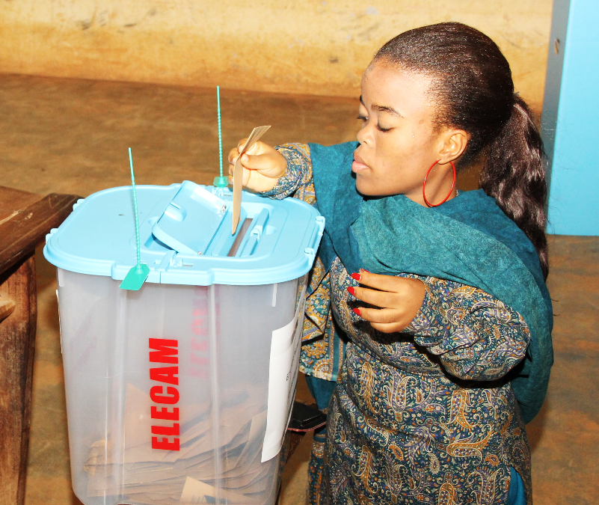
IFES Approach to Disability Inclusion
Organizational
Programs
Equal opportunity hiring
Proactively mainstream disability in all programming
Develop disability-specific programming
Staff training
Disability Rights Working Group
Inclusion Insights
Reasonable Accommodation Policy
Security plans and office space
Disability rights indicators
Notes:
IFES focuses on advancing good governance and democratic rights. In order to advance that mission, IFES emphasizes empowerment of underrepresented populations to participate in political process
The World Health Organization estimates that 1 out of every 7 people in the world has a disability – over a billion people
IFES has worked in over 60 countries since 1997 on disability rights and inclusion. IFES has a dedicated team working on mainstreaming disability in our programs, as well as developing disability specific initiatives
We received the 2011 InterAction Disability Inclusion Award and the 2015 Zero Project Innovative Practice Award
IFES has made changes to policies and procedures at HQ as well as to our approach to programming.
Photo from Cameroon

Slide 3
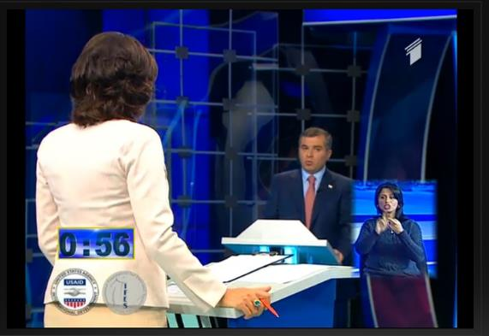
Article 29 of the CRPD
“States Parties shall…ensure that persons with disabilities can effectively and fully participate in political and public life on an equal basis with others…”
Notes:
The international standard for disability inclusive elections is outlined in the UN Convention on the Rights of Persons with Disabilities, which has been ratified by nearly 90% of member states.
To facilitate inclusion, IFES works to spread awareness of CRPD obligations, especially among EMBs as they are often unaware of the commitments their country has made under the CRPD. Article 29 is fundamental to inclusive elections. Given the high percentage of adoption to the UN disability treaty, your government has likely already made a commitment to disability rights.
People with disabilities are among the most underserved citizens in your country. As an EMB, you have the opportunity to be a role model for other government ministries on how easy it is be inclusive. A few simple policy and procedure changes can make a big difference to the experience of a citizen with a disability during the electoral cycle. These adjustments are within your power and do not require law reform.
If you integrate a disability rights perspective in your work from start, it is very easy to be inclusive. Today, I am going to share some good practice examples from EMBs around the world. Some of these ideas might seem complicated the first time, but will very easily become routine.
Photo from Georgia – shows sign language interpreter in a debate

Slide 4
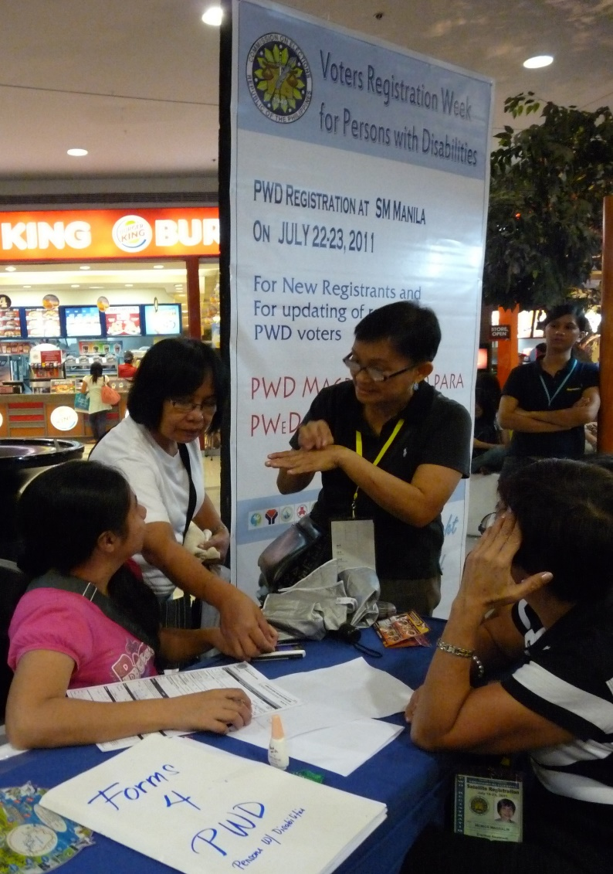
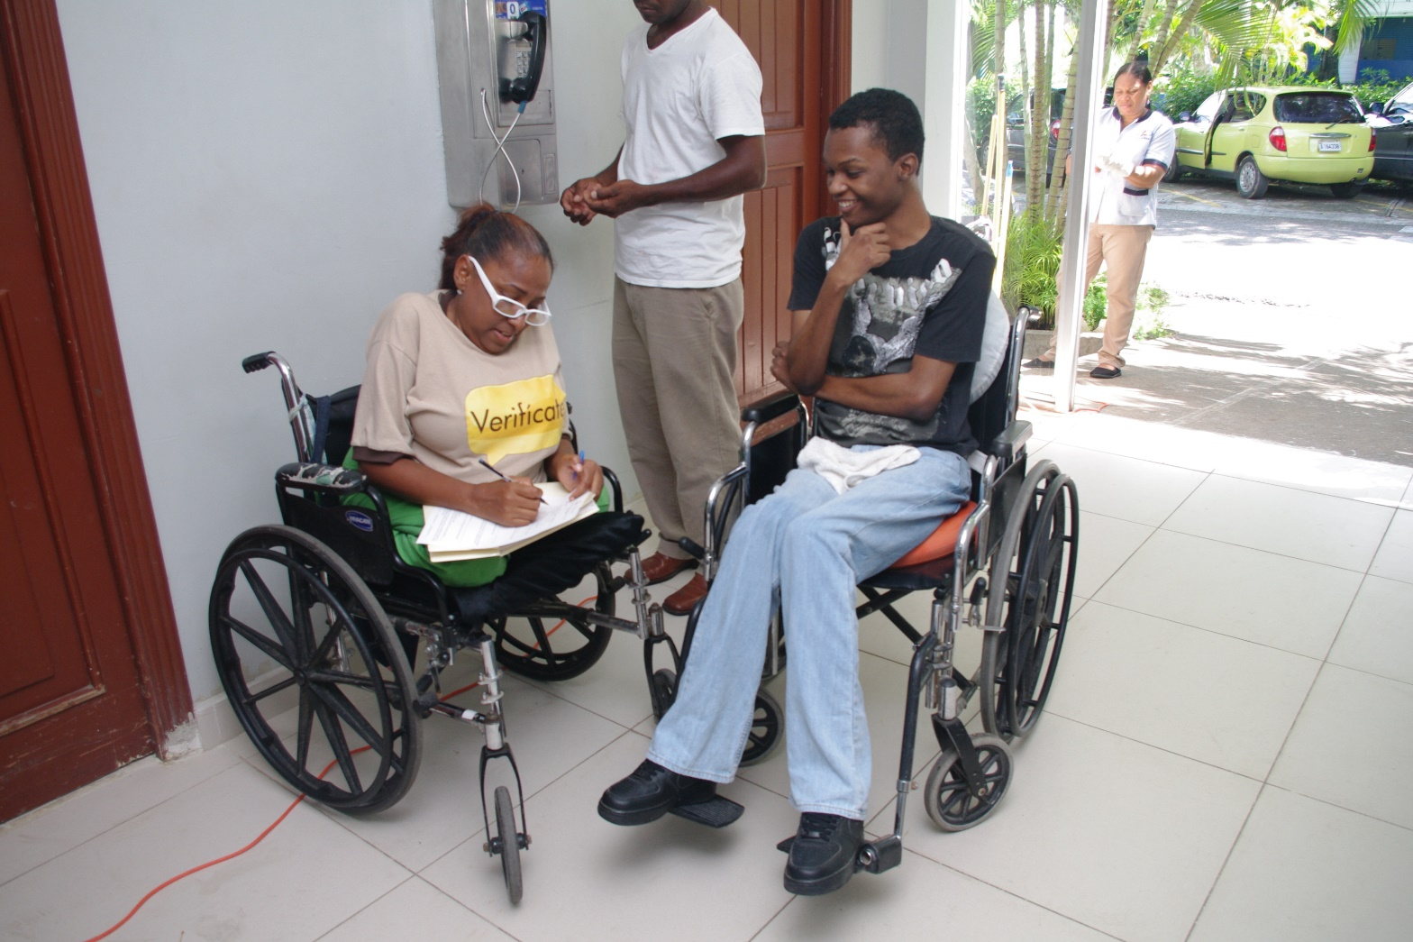
Voter Registration
Notes:
Voter registration is arguably the most crucial part of the electoral cycle to make inclusive. If people with disabilities do not have access to register, any of the changes you make later will not matter.
As shown in the photo on the right, in the Philippines, the COMELEC set up voter registration centers in shopping malls. As some of the most accessible buildings in the country, this allowed for ease of access, but malls were also a more convenient location for people with disabilities to visit, as opposed to a government office. This pilot was so successful that it has spread across the country and there is now a pilot voting in malls initiative as well. The voter registration form in the Philippines asks voters what type of assistance they might need on election day. By collecting this information in advance, the COMELEC can better prepare to welcome voters on Election Day.
In the Dominican Republic, the JCE hired people with disabilities to serve as workers during their “Verificate” campaign. These workers went to locations like rehab centers, shown here on the left, where they were likely to find people with disabilities, to confirm their registration details. By both hiring people with disabilities and targeting their campaign, the JCE made a big difference in ensuring people with disabilities were included.

Slide 5
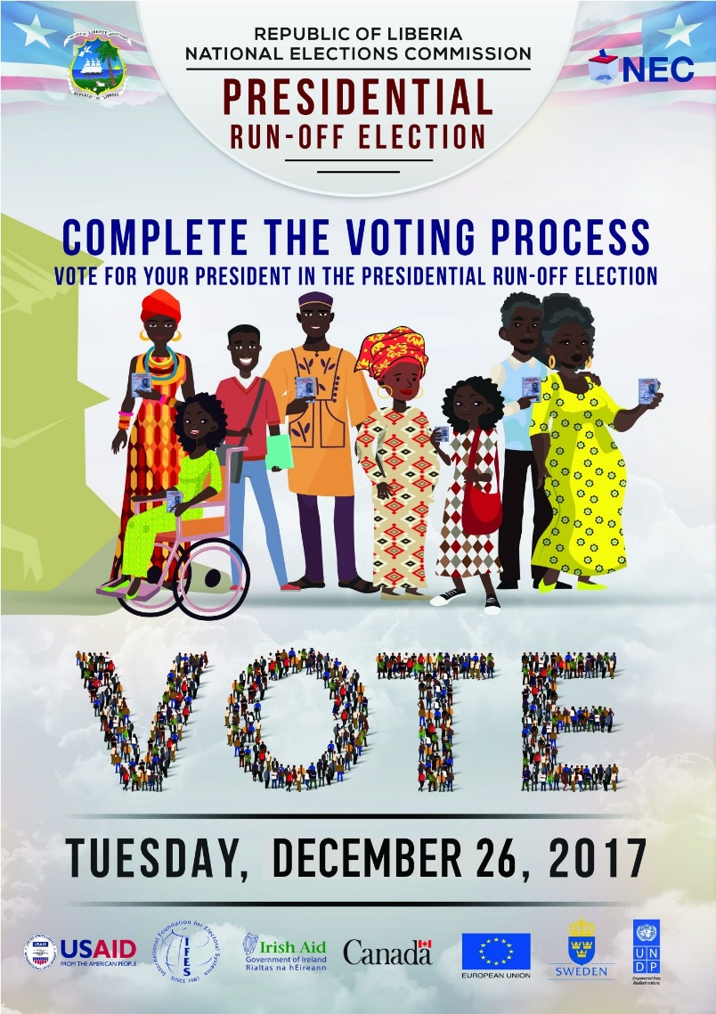
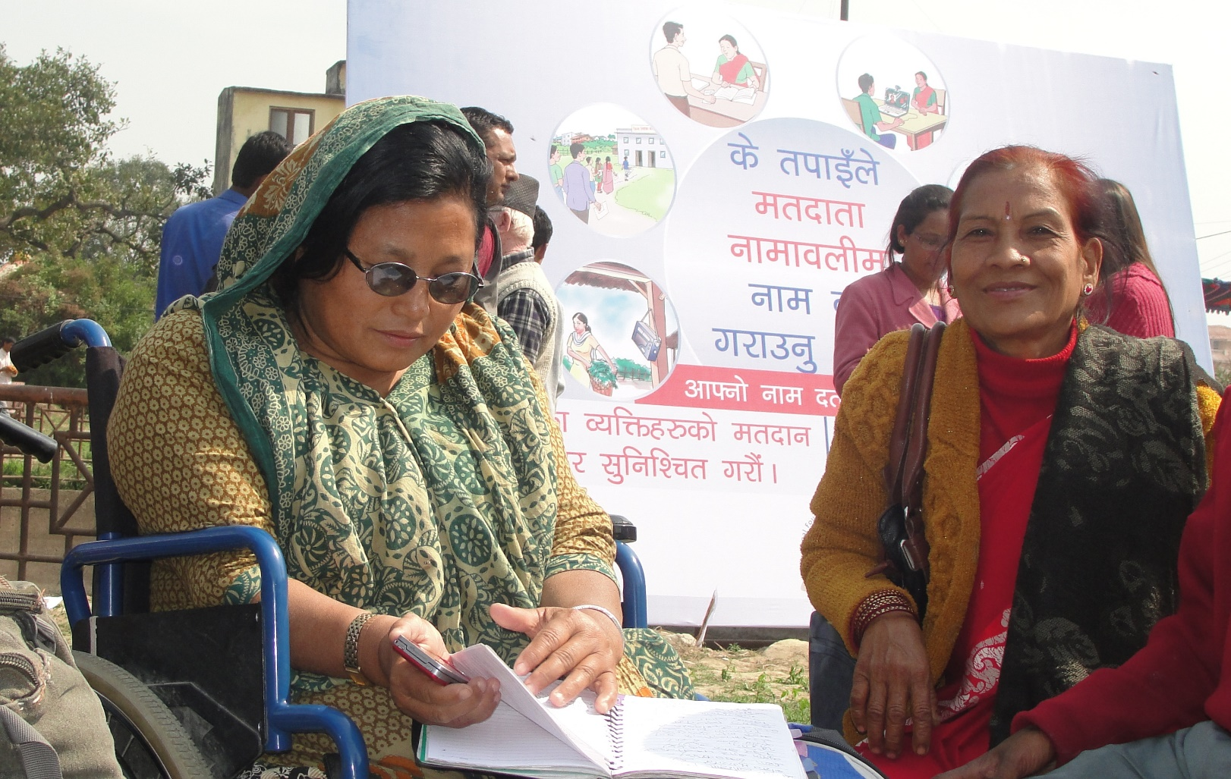
Voter Education
Notes:
Voter education is the next key area for EMBs to think about in terms of inclusion. You should mainstream people with disabilities in broader messages to the public and you should also develop content targeting people with disabilities in accessible formats.
Mainstreaming is easy – it does not cost anything extra to draw an image of a person with a disability in a brochure or comic. It is simple to hire an actor with a disability to participate in a video message. For example, this poster on the left is from Liberia’s December 2017 Presidential run-off election. It includes an image of a woman with a disability alongside her fellow citizens. Drawing this image did not cost any extra money, you just have to think about it.
It is also important to develop materials in accessible formats, like sign language, braille or large font. The image on the right is Nepal and shows a woman reading voter education material in braille. There are disabled person’s organizations in every country, they can help you identify where people with disabilities live in order to better target dissemination of accessible materials.

Slide 6
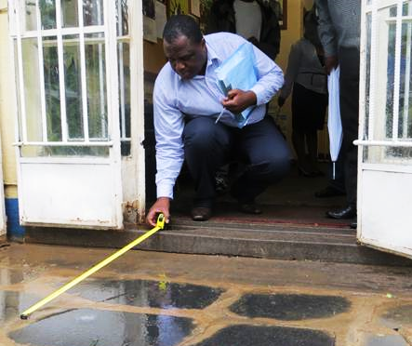
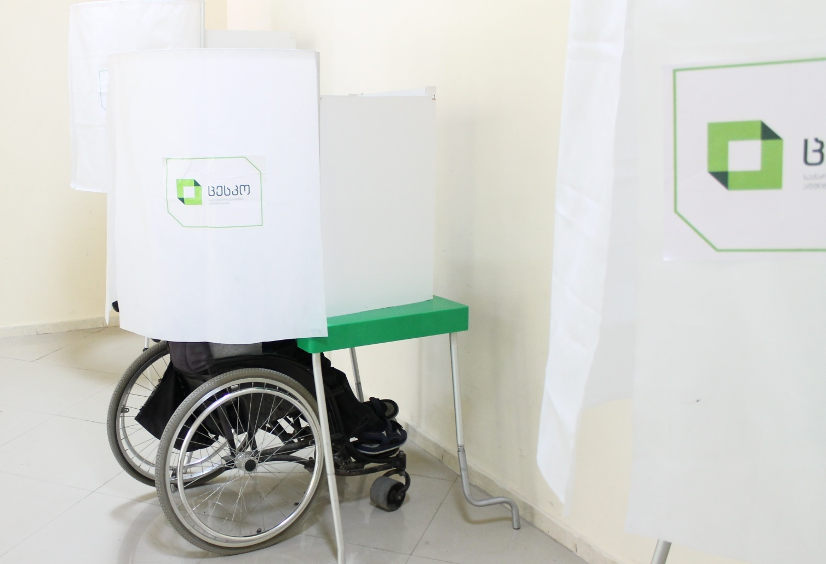
Polling Station Access
Notes:
Once voters with disabilities are registered to vote and have received information about the electoral process, entering and maneuvering around the polling station is often another barrier.
In Zimbabwe, people with disabilities conducted audits of polling stations and shared their findings with the ZEC. The ZEC has begun adding ramps to many of the polling stations identified as inaccessible. This is a long-term process, but also has the added benefit of making schools accessible to students and teachers with disabilities.
Once inside, polling stations should be set up with enough room for wheelchair users to freely move and materials should be accessible. This image from Georgia shows an accessible voting booth. These lower booths are often also appreciated by older voters, who would prefer to mark their ballot sitting down.

Slide 7
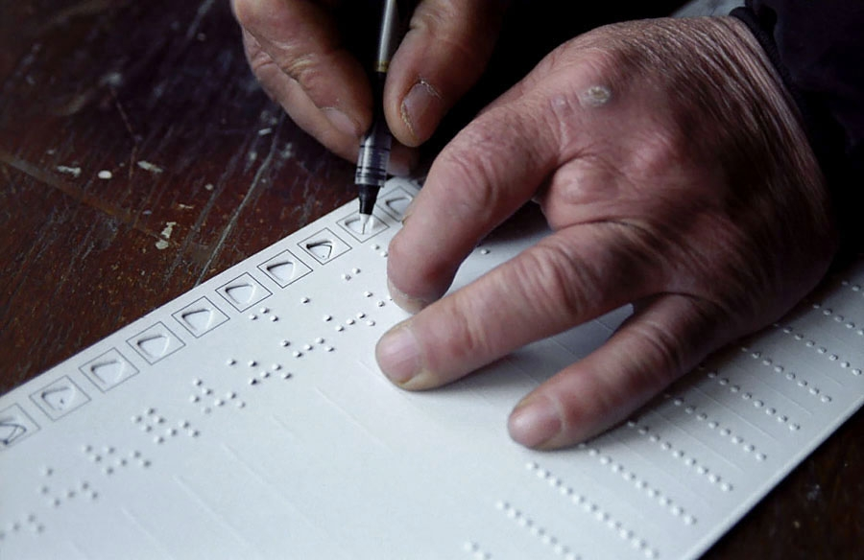
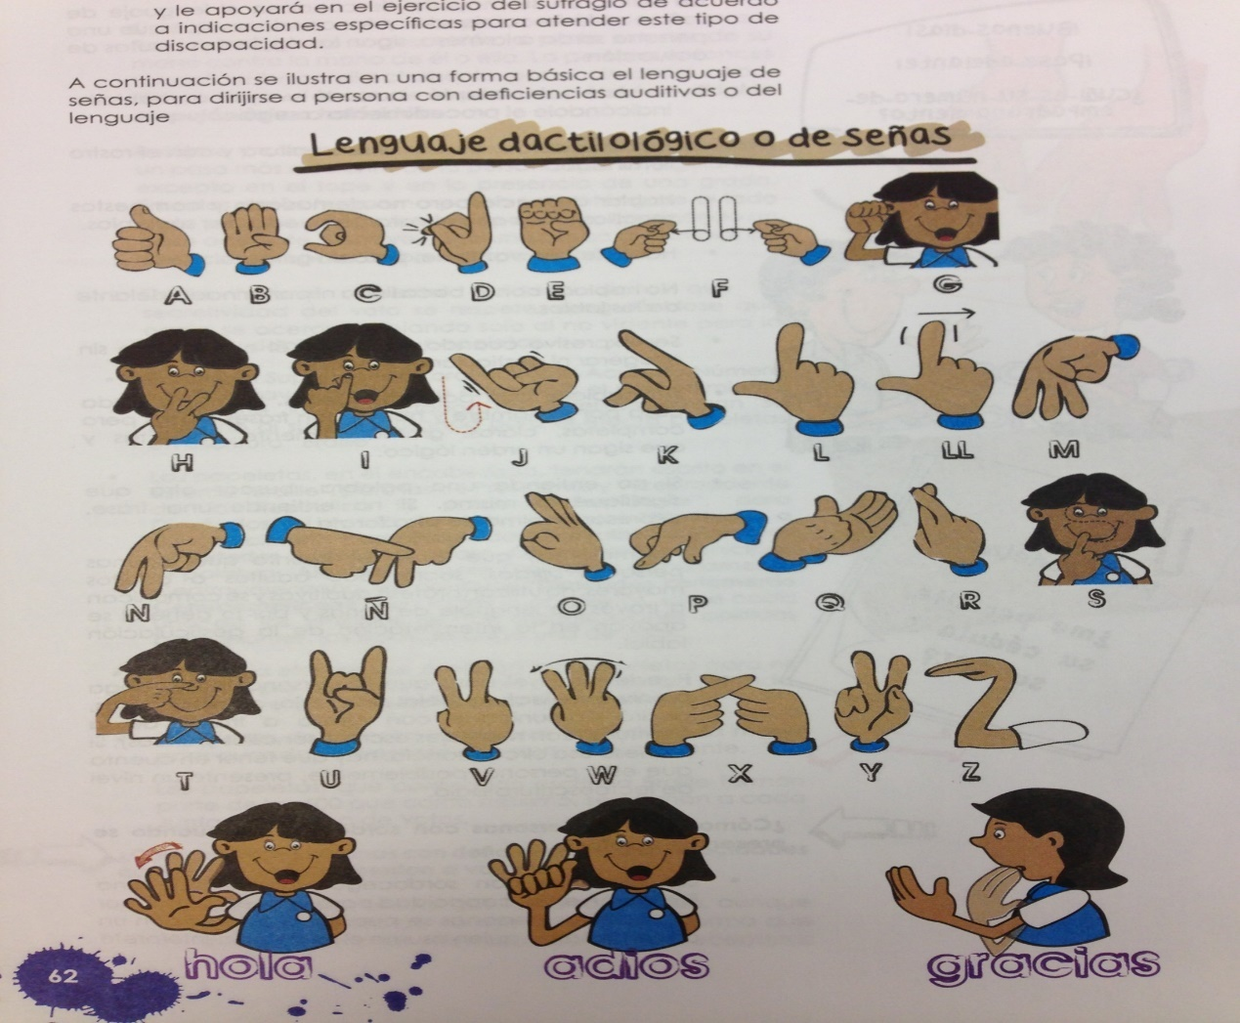
Assistive Devices and Poll Worker Training
Notes:
In addition to accessible voting booths, EMBs should also strive to develop tactile ballot guides. These tools allow people who are blind to vote on their own and in secret. This tactile ballot guide from Armenia is a good example because it includes both braille and tactile dots, for those who are not literate in braille. A tactile ballot guide is a better solution than a tactile ballot because when the sleeve is used, the voter’s ballot looks like all of the other ballots.
The experience of voters with disabilities, just like with their fellow citizens, can be greatly improved if they have positive interactions with poll workers. Inclusive poll worker training encourages poll workers to be responsive to the needs of voters with disabilities. For example, in Guatemala, all poll workers learned how to say hello, goodbye and thank you in sign language. Imagine how much more welcome Deaf citizens would feel if they were greeted in their language!

Slide 8
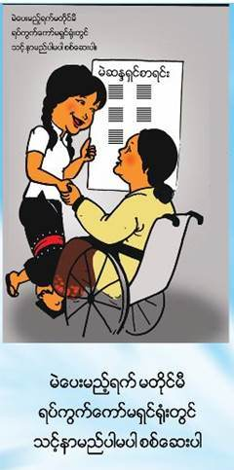
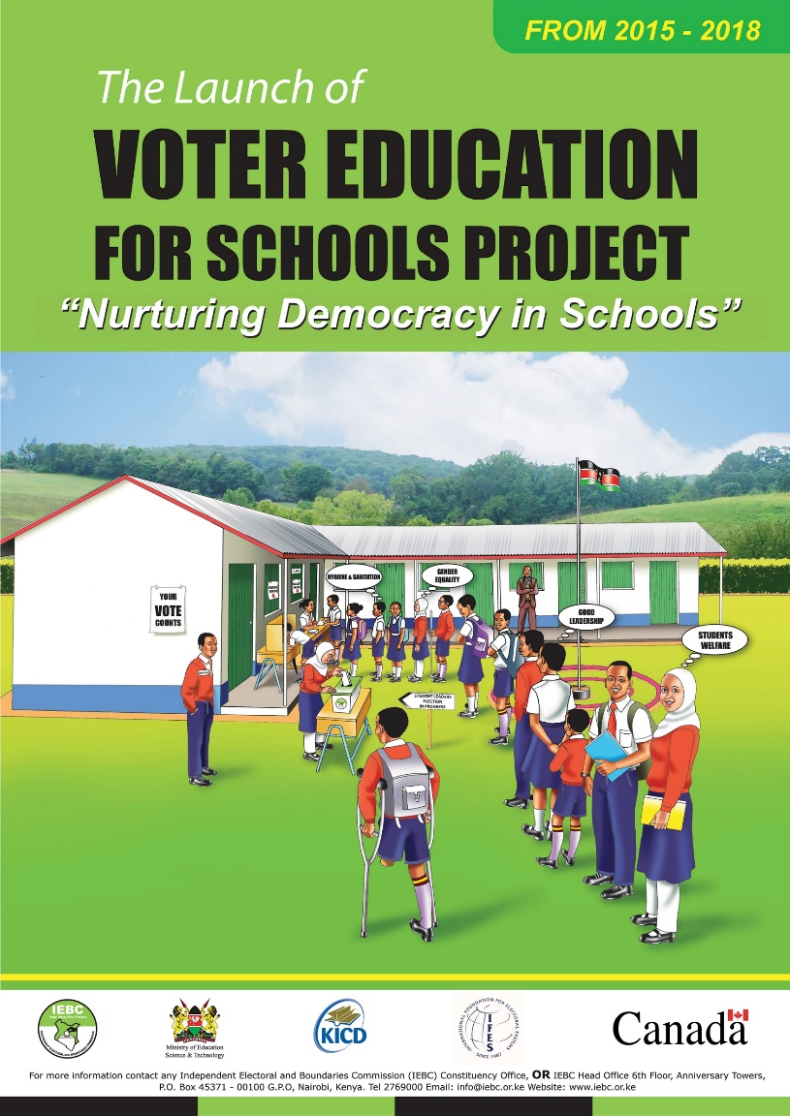
Women’s Empowerment and Youth Leadership
Notes:
* Lastly, I would like to highlight intersectionality. Many election commissions develop targeted information to women or youth. It is important to remember that there are women with disabilities and youth with disabilities!
* This image on the left from Myanmar shows how easy it is to include women with disabilities in broader efforts targeting women. The poster on the right is from Kenya. It was produced as part of the IEBC’s Voter Education for Schools Project and again integrates images of young people with disabilities.

Slide 9
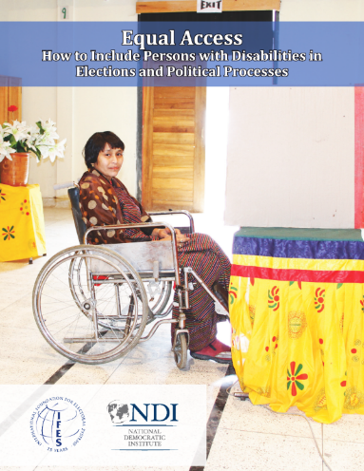
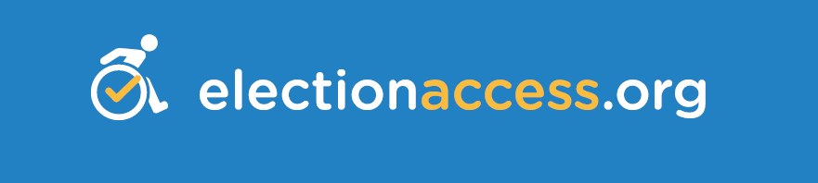
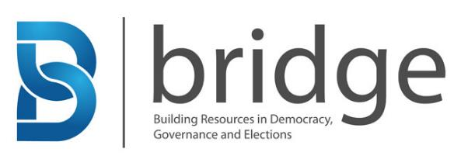
IFES Resources
Notes:
These are just a few examples of good practices from your colleagues. IFES has developed several resources to disseminate additional good practices and lessons learned. These include:
ElectionAccess.org is the world's first and only resource solely dedicated to the global political rights of persons with disabilities, which features resources such as a library of legal excerpts from relevant international and national laws and examples of inclusive voter education from around the world.
Website includes accessibility features such as compatibility with screen readers, a text-to-speech program, and transcripts for all videos. All good practices for EMB websites as well.
IFES developed the first Building Resources in Democracy and Elections (BRIDGE) module on disability rights and elections.
The BRIDGE curriculum includes interactive lessons for election stakeholders that build knowledge on disability rights, and can be adapted to fit country contexts.
Piloted in several countries including Egypt, Fiji, Haiti, Sri Lanka and Ukraine
The Equal Access manual offers election and disability rights professionals an in-depth review of ways to involve persons with disabilities as leaders and equal participants in the electoral cycle. It is available in 10 languages, including Urdu, Bahasa Indonesia and Nepali.

Slide 10
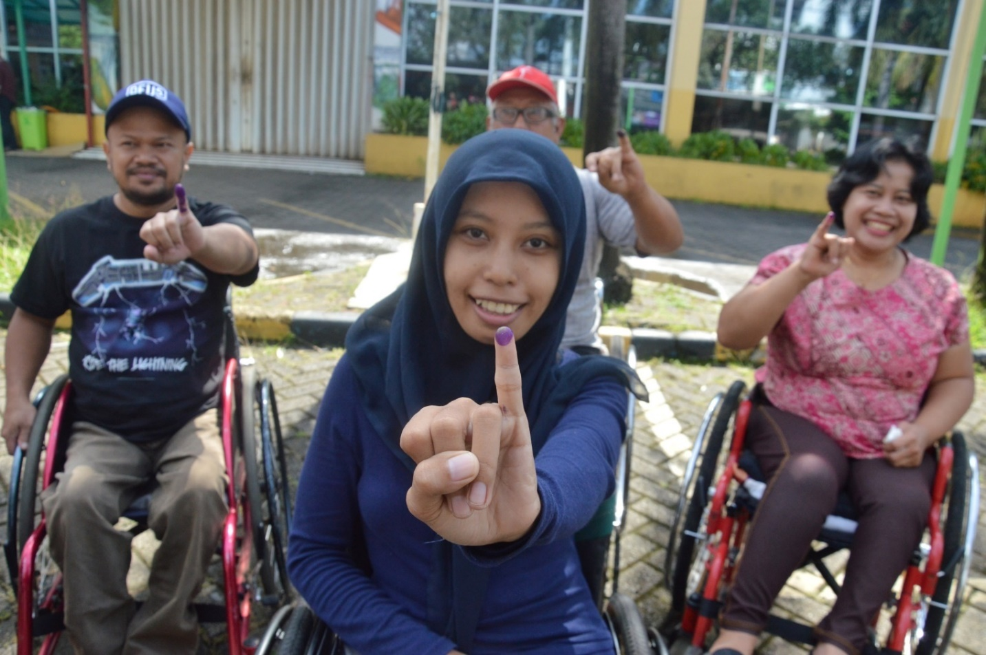
Questions?
Bill Sweeney
(bsweeney@ifes.org)
Notes:
Photo from Indonesia

